Slide 1
Searching for Success
Using google searches to predict the stock market

Slide 2
Background
Every fiscal quarter, every public company releases their quarterly earnings to the public
These are generally the most significant events for a company’s share price
Amateur investors are competing against complex algorithms and professional day traders who follow the market religiously, making gaining an edge in the market very difficult
If an investor can predict a company’s quarterly performance before the release of the earnings, the investor can invest accordingly and potentially realize significant returns
Google Search volume for certain keywords could show if a certain company is enjoying a better quarter than usual

Slide 3
Use Case
An amateur investor can use our tool to visualize search trends for the keywords that our model has identified as indicators.
Visualize the performance of the stock relative to the S&P 500
Depending on the search volume of relevant keywords, our model will give a probability that the stock price will increase when the quarterly reports will be released
EG Output : 0.65. Interpreted as the 65% chance the stock performance increases.
Note: No prediction of the stock price itself

Slide 4
Package Used
Understanding Trends Data
Unbiased sample of Google search data
Normalized data
Data is indexed at 100, where 100 is the maximum search interest for the time selected.
15 keywords search trends for Q-2 past 10 years.
Pytrends
Python package that uses data from Google trends
Google account login is required
Search of 3 month period yields daily data
Only relative search data amongst only 5 keywords

Slide 5
Design
Main Functions
Earning Report– Calculates the expected date of Earnings call for the selected company
Prediction Stock Price – Uses LASSO regression to identify the keywords that have the highest impact on the stock price, and Logistic Regression with the identified keywords to calculate the likelihood of stock price change
Historical Data Plot – Displays plot for the stock performance and selected keywords trends over 10 years

Slide 6
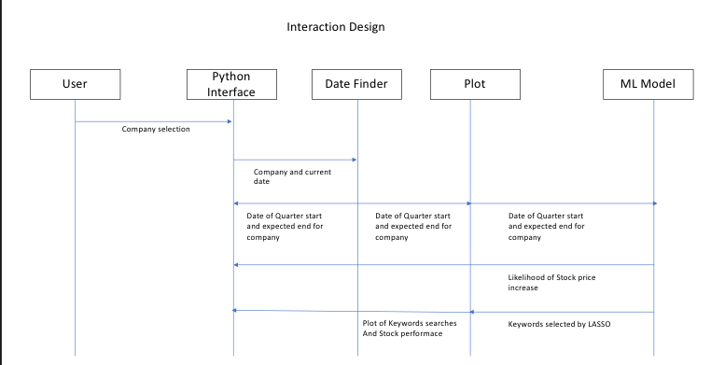
Project Structure

Slide 7
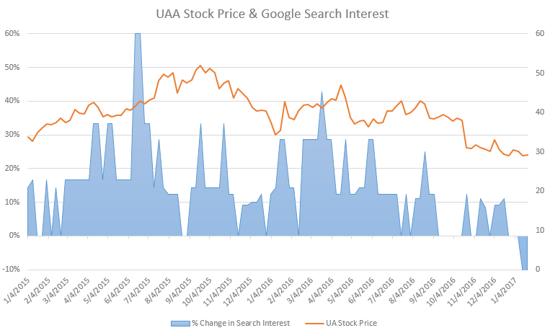
Control Logic – Earnings Report Module
Based on Google trend search data collected each day of a quarter, can we predict the direction of stock price change after a technology company reports quarterly earnings?
To do this, we need:
the start and end dates of each quarter to parse our Google trends data
the dates each company reports their quarterly earnings, so we know when to make a prediction

Slide 8
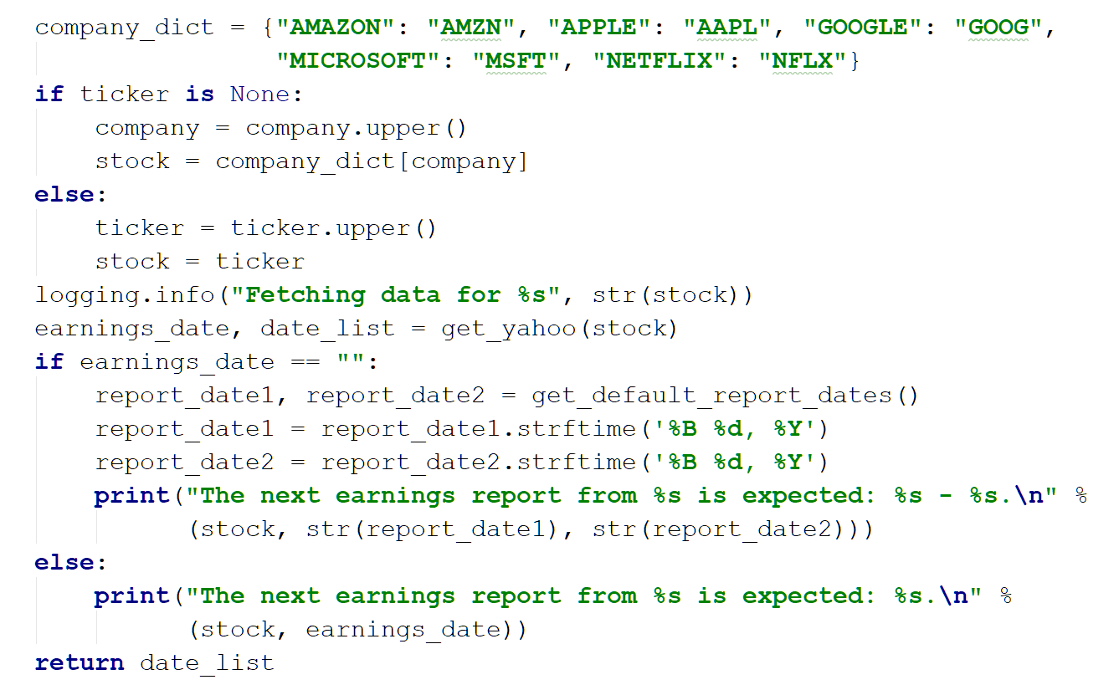
Control Logic – Earnings Report Module
get_earnings_data(company, ticker=None):
Get earnings release date from Yahoo finance
If N/A, then get default dates

Slide 9
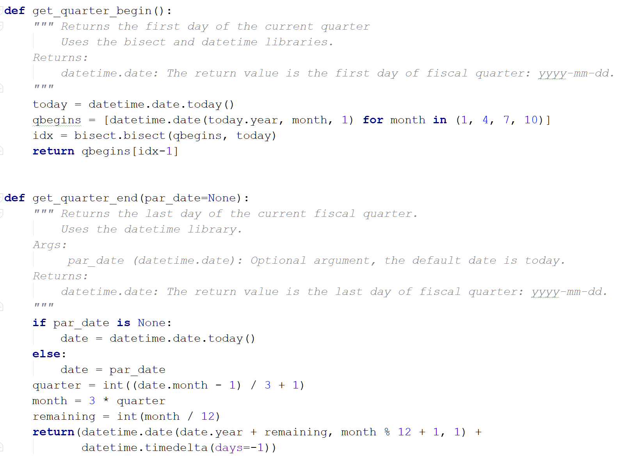
Control Logic – Earnings Report Module
Constructing dates for 1st day of Jan., April, July, & Oct. of current year
get_quarter_begin():
get_quarter_end(par_date=None):
Constructing end dates is trickier b/c sometimes the year, month & day all change

Slide 10
Control Logic – PredictionStockPrice Module
Use LASSO regression to identify the keywords that have the highest impact on the stock price.
Inputs:
Potential Keywords and their Google Trend Index from PyTrends
Daily stock performance of Company
Outputs:
A smaller list of keywords that have a high impact on the prediction model.
Logistic Regression with the identified keywords to calculate the likelihood of stock price change.
Inputs:
Keywords identified by LASSO.
Stock Performance of Company.
Dates
Output:
A probability of the stock going up or down when the quarterly reports are published.
A success or failure statistic on the success of the model.
Keywords selected by ML Model for Amazon: Amazon Kindle, Amazon Order, Amazon Recall, Amazon Sucks, Amazon Echo, Amazon dvd

Slide 11
Control Logic – HistoricalDataPlot Module
Graphs for the stock performance and selected keywords trends over 5 years

Slide 12
Demo

Slide 13
Lessons Learned
Define Project scope as early as possible
Working with new libraries can be difficult, e.g. manipulating dates with the datetime library and parsing JSON files
Problems Encountered
Not everyone was able to import the EarningsReport module (still trying to figure that out)
Couldn’t get Beautiful Soup or other scraping tools to work beyond getting the Yahoo quote data

Slide 14
Thanks!

